Slide 1
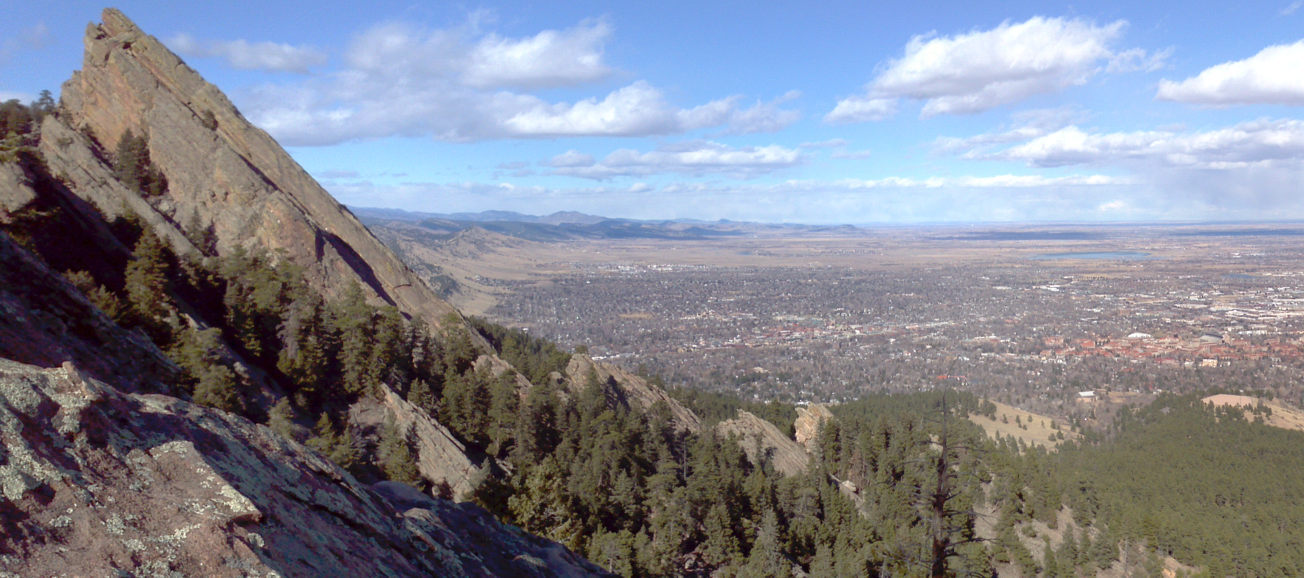
WRFDA Practical Sessions
Michael Kavulich
WRFDA Tutorial, July 2013, NCAR

Slide 2
Computers
Look for your name on the side of the room here or the door to the classroom
There you will find your computer assignment and your login ID
19 Available computers
CentOS Linux Operating System, 32-bit
PGI compilers
8 Processors
Some have 2 screens, some have 1

Slide 3
Practice website
Website: http://www.mmm.ucar.edu/wrf/users/wrfda/Tutorials/2013_July/
You can find it by clicking the “WRFDA” tab on the homepage:

Slide 4
Code access
All code has been pre-compiled for you
Can compile yourself later as a practice
Code location: /wrfhelp/SOURCE_CODE
WRFDA: WRFDA_compiled.tar.gz
WRFPLUS: WRFPLUS_compiled.tar.gz
WRFDA TOOLS: WRFDA_TOOLS_v3.5.tar.gz

